Slide 1
GPIO and Interrupt
Dr. Federica Villa

Slide 2
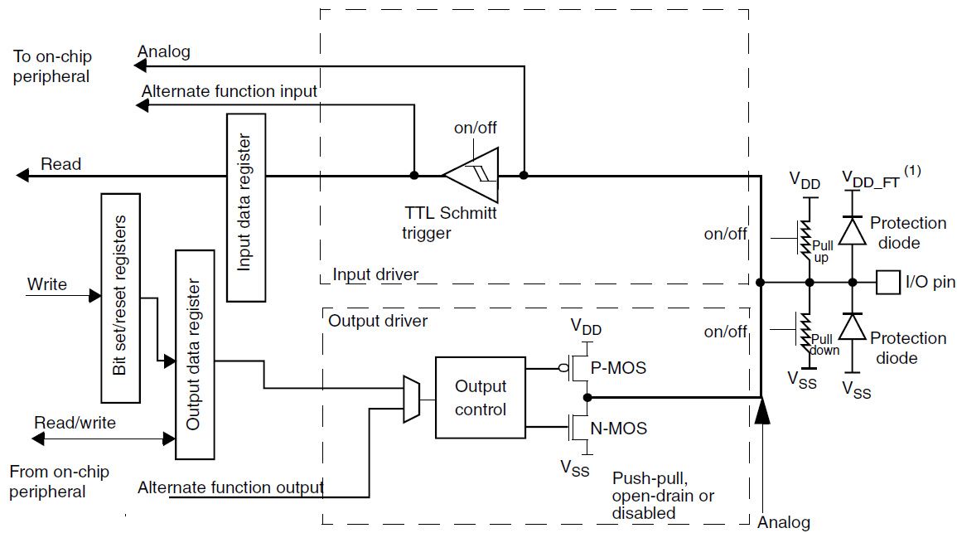
General Purpose Input/Outputs
GPIO:
6 ports (A…E, H)
each port 16 PIN
… but in STM32F401RE we have less GPIOs
Notes:
Port FG does not exist in STM32F401

Slide 3
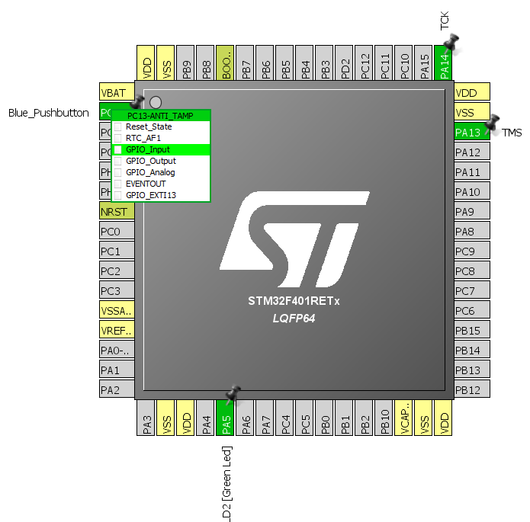
CUBE project Pinout
Open a new project (use default)

Slide 4
GPIO HAL functions
GPIO_PinState HAL_GPIO_ReadPin(GPIO_TypeDef* GPIOx, uint16_t GPIO_Pin)
void HAL_GPIO_WritePin(GPIO_TypeDef* GPIOx, uint16_t GPIO_Pin, GPIO_PinState PinState)
void HAL_GPIO_TogglePin(GPIO_TypeDef* GPIOx, uint16_t GPIO_Pin)
__weak void HAL_GPIO_EXTI_Callback(uint16_t GPIO_Pin)
function called in the interrupt routine (after flag reset), it can be redefined by user in main.c

Slide 5
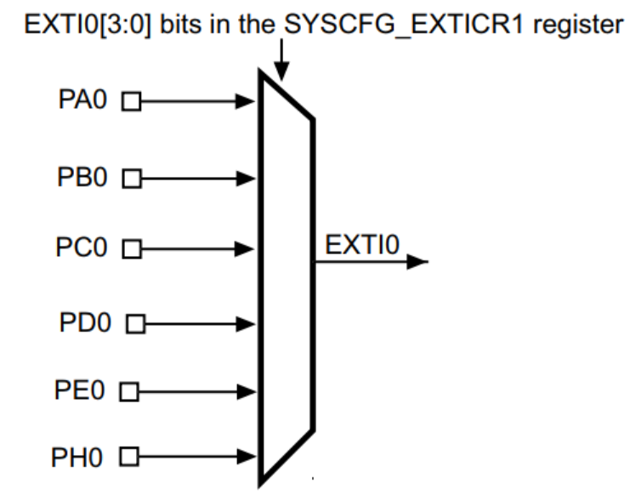
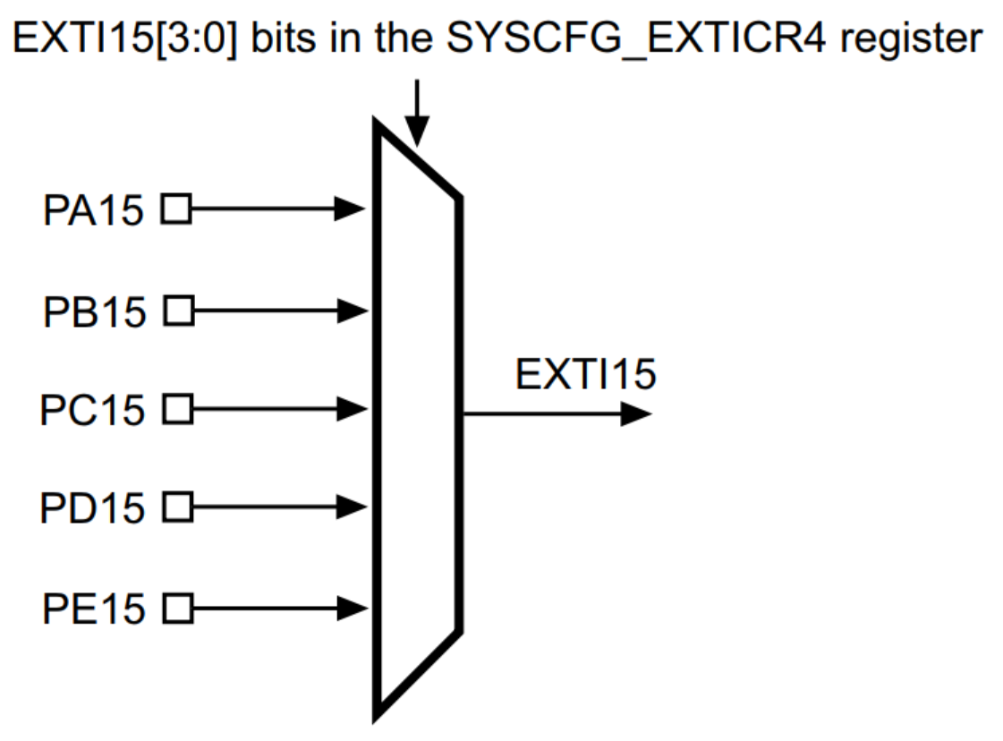
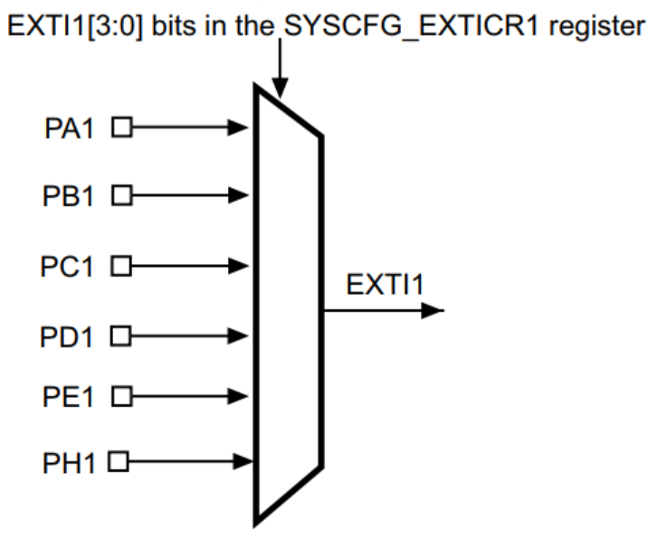
External interrupt/event line mapping
Up to 81 GPIOs (STM32F401xB/C and STM32F401xD/E) are connected
to the 16 external interrupt/event lines in the following manner:
The five other EXTI lines are connected as follows:
− EXTI line 16 is connected to the PVD output
− EXTI line 17 is connected to the RTC Alarm event
− EXTI line 18 is connected to the USB OTG FS Wakeup event
− EXTI line 21 is connected to the RTC Tamper and TimeStamp events
− EXTI line 22 is connected to the RTC Wakeup event

Slide 6
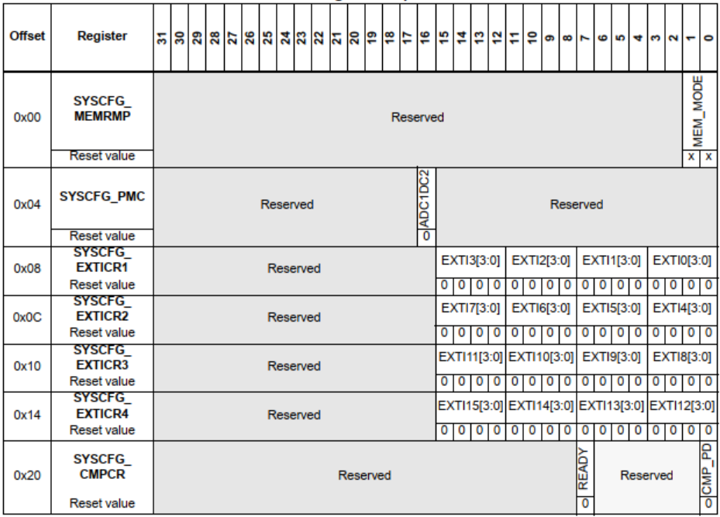
SYSCFG Register map

Slide 7
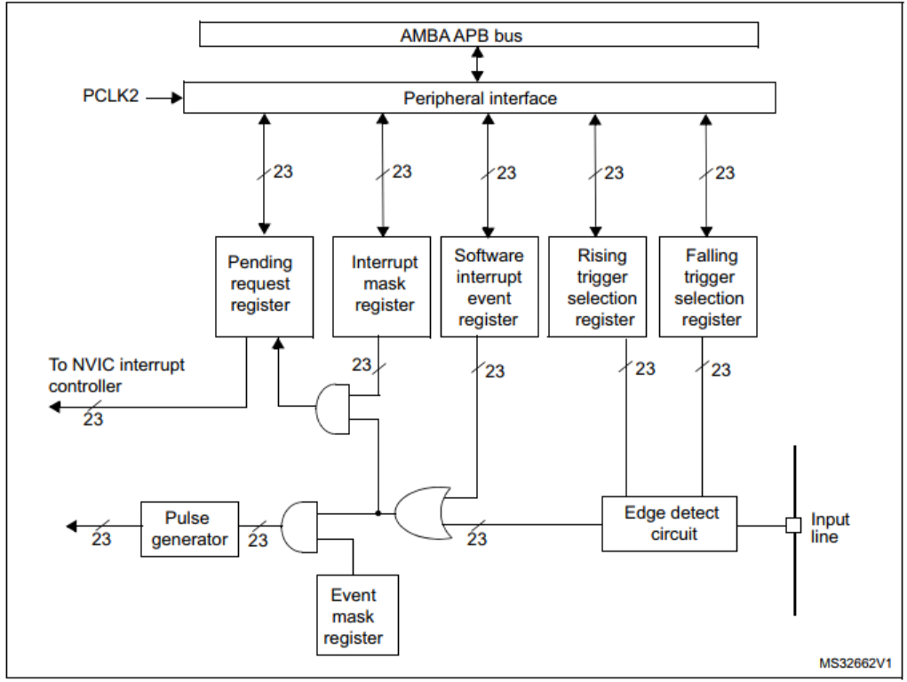
EXTI block diagram

Slide 8
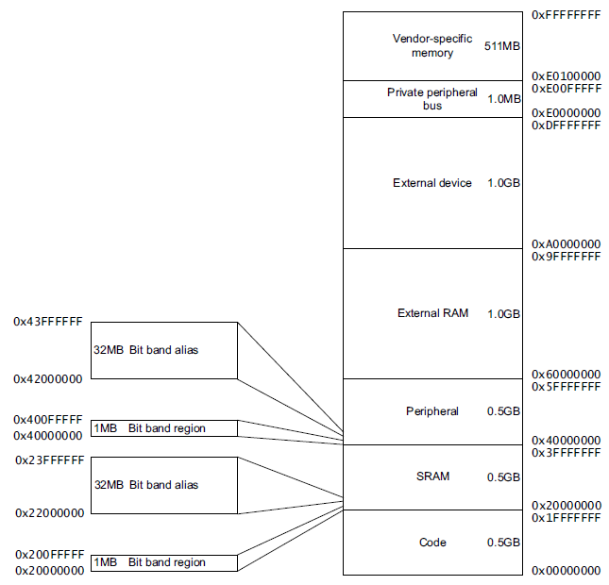
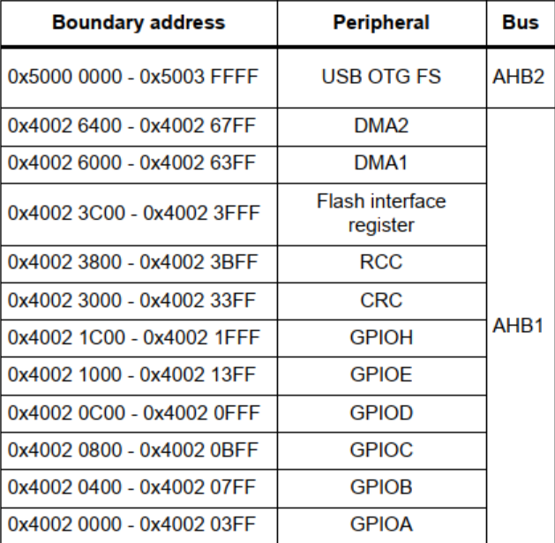
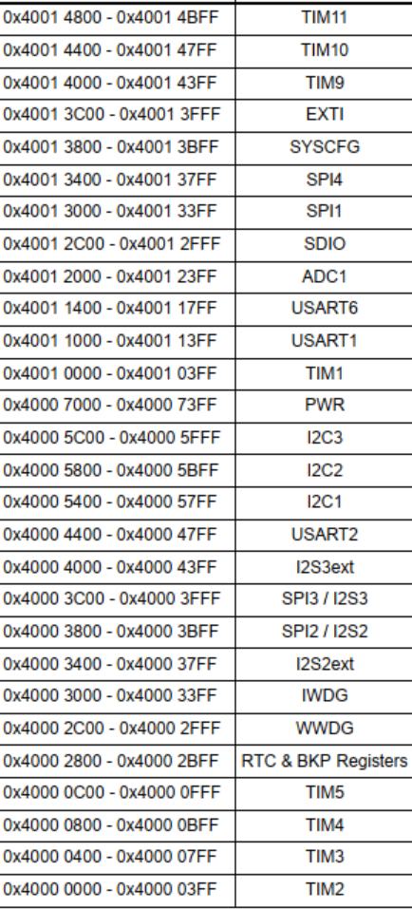
EXTI location in memory

Slide 9
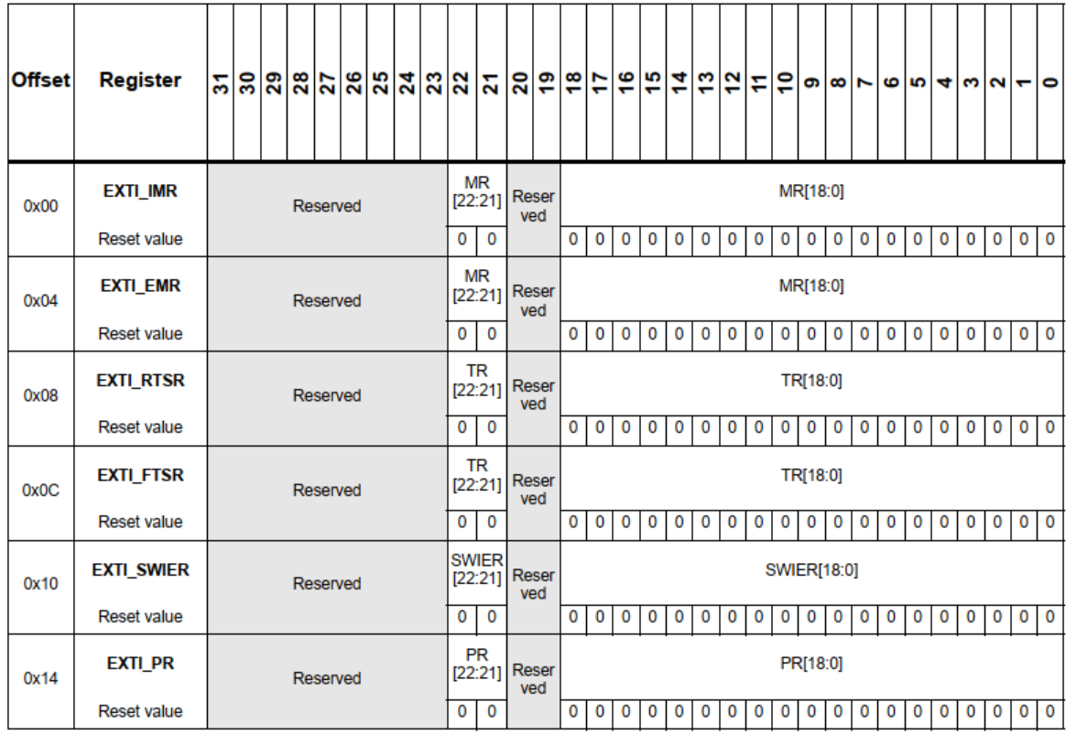
EXTI register map

Slide 10
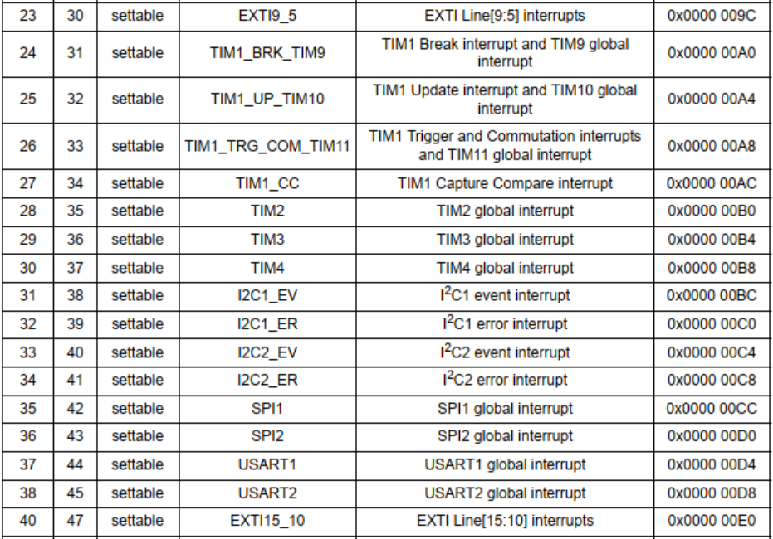
EXTI vector table

Slide 11
Interrupts
Interrupts must be enabled in CUBE
All the interrupt routines are handled in stm32f4xx_it.c

Slide 12
Project 1a: Pushbutton - polling
Objective of this project is to switch on the green LED on Nucleo board (LD2), every time the blue pushbutton is pressed and to switch it off when the pushbutton is released.
A polling operation will be used to monitor the state of the pushbutton.

Slide 13
Project hints
Use the NUCLEO board Manual to find the GPIO connected to the blue push-button and LD2.
Configure the GPIO in CUBE and generate the code.
In NUCLEO board Manual find the state of the blue button (0 or 1) when it is pressed.
Use the GPIO function the check the state of the push-button and consequently update the state of LD2.
Debug and verify if the LED is ON when you press it and OFF when you release it.

Slide 14
Project 1b: Pushbutton - interrupt
Objective of this project is to switch on an LED every time the blue pushbutton is pressed, and to switch it off when the pushbutton is released.
The pushbutton input will be used in interrupt mode.

Slide 15
Project hints
Configure CUBE, remembering to enable the interrupt for the pushbutton. Note that you need to modify the status of the LED both when you press and when you release the pushbutton.
Check in the stm32f4xx_it.c file that the routine which handles the EXTI from the pushbutton has been automatically prepared by CUBE.
Use the HAL_GPIO_EXTI_Callback to manage the interrupt (switch ON/OFF the LED), using the GPIO functions.
Debug and verify if the LED is ON when you press it and OFF when you release it. You should see the same behavior you had in the first project (polling), but now you are not using CPU resources just to wait for an event!

